Slide 1
ACTG A5353: A pilot study of dolutegravir (DTG) + lamivudine (3TC) for initial treatment of HIV-1-infected participants with HIV-1 RNA <500,000 copies/ml
¹Babafemi O. Taiwo, ²Lu Zheng, ³Amesika N. Nyaku, ²Andrei Stefanescu, ⁴Paul E. Sax, ⁵David Haas, ¹Baiba Berzins, ⁶Carole L. Wallis, ⁷Kimberly Y. Smith, ⁷Belinda Ha, ⁸Catherine Godfrey, ⁹Johnstone Kumwenda, ¹⁰Edward Acosta, ¹¹Beverly E. Sha, ¹²Cornelius Van Dam, ¹³Roy M. Gulick
¹Northwestern University, Chicago, U.S., ²Harvard School of Public Health, Boston, U.S., ³Rutgers, New Jersey Medical School, Newark, U.S., ⁴Brigham and Women's Hospital, Boston, U.S., ⁵Vanderbilt University, Nashville, U.S., ⁶BARC-SA/Lancet Laboratories, Johannesburg, South Africa, ⁷ViiV Healthcare, Research Triangle Park, U.S., ⁸NIH, NIAID, Division of AIDS, Rockville, U.S., ⁹College of Medicine, Johns Hopkins Project, Blantyre, Malawi, ¹⁰University of Alabama, Birmingham, U.S., ¹¹Rush University Medical Center, Chicago, U.S., ¹²Greensboro Clinical Research Site, Greensboro, U.S., ¹³Weill Cornell Medicine, New York, U.S.

Slide 2
Conflict of Interest Disclosure
Served as a paid consultant to ViiV Healthcare, GSK, Gilead and Janssen, and received research support through Northwestern University from ViiV, GSK, and Pfizer

Slide 3
Background
Dolutegravir (DTG) + Lamvudine (3TC) is an investigational 2 drug regimen.
Strengths of DTG + 3TC
Two potent, well tolerated drugs
Robust resistance profile of DTG – no emergent resistance in almost 1400 participants in phase 2/3 trials (48-144 weeks) of DTG + 2NRTIs
Potential for co-formulation
Possibly reduced risk of cumulative adverse effects
Could save $550 million to > $3 billion in ART costs in the US over 5 years²
Unknowns and potential weaknesses
Efficacy at baseline VL > 100,000 copies/mL (cpm)
Low resistance barrier of 3TC
Contraindicated with hepatitis B co-infection
Efficacy in compartments (genital, CNS) and pregnancy
1.Giroud P, et al. CID 2016 62(6):784-91

Slide 4
PADDLE
A pilot study of DTG 50 mg + 3TC 300 mg daily¹
Showed plasma VL < 50 cpm at week 48 in 18/20 participants (1 suicide; 1 protocol defined virologic failure, PDVF)
Limitations
Small sample size (N=20), single arm
Excluded screening VL >100,000 cpm
Excluded screening CD4 count < 200 cells/mm³
Data insufficient to justify enrollment of participants with high baseline VL in phase 3 studies
Genotyping performed on the participant with PDVF showed no reverse transcriptase (RT) mutations; integrase did not amplify
1. Cahn et al. J Int AIDS Soc 2017; 20(1):1-7

Slide 5
ACTG A5353 Study Design and Objectives
Phase II, single-arm, 52-week, study of DTG 50 mg + 3TC 300 mg in treatment-naïve participants with VL ≥1000 and <500,000 cpm
Primary Objective
To estimate the virologic success rate at week 24
Key Secondary Objectives
Compare efficacy with baseline VL ≤100,000 vs >100,000 cpm
Describe emergent integrase and RT resistance during virologic failure
Evaluate safety and tolerability
Explore impact of minority drug-resistant variants and drug exposure/adherence on observed outcomes

Slide 6
Key Eligibility Criteria
Antiretroviral drug naïve
VL ≥1000 and <500,000 cpm
Pre-specified enrollment of ≥ 25% with VL >100,000 cpm
No evidence of RT, integrase, or major protease resistance mutation
Integrase genotyping was performed by the study at screening
Negative hepatitis B surface antigen
No active/anticipated HCV treatment within study period.
HCV infection alone was not exclusionary

Slide 7
Outcome Measures
Primary Efficacy Outcome
Virologic success at week 24, defined as on-treatment VL < 50 cpm, using the FDA Snapshot definition.
Protocol Defined Virologic Failure (PDVF) Definition
Confirmed VL >400 cpm at week 16 or 20
or
Confirmed VL >200 cpm at/after week 24

Slide 8
Participant Disposition Up to Week 24
165 screened
43 did not enroll
9 genotype failed
14 RNA/lab out of range
9 not willing to enroll
7 screening window expired
4 illness
122 enrolled
2 ineligible and excluded
K103N at screening
120 initiated DTG + 3TC
37 > 100,000 copies/mL
83 ≤ 100,000 copies/mL
4 discontinued study & DTG+3TC before week 24
2 moved out of area
1 incarceration
1 unable to contact
3 discontinued DTG+3TC before week 24
1 pregnancy
1 non-compliance
1 unable to attend clinic

Slide 9
Baseline Characteristics
 |  | Baseline HIV-1 RNA Category
 |  | > 100,000 cpm (N=37) | <100,000 cpm (N=83)
Age (years) | Median (Q1, Q3) | 30 (25, 40) | 30 (24, 42)
Sex | Male | 89% | 86%
Race/Ethnicity | White Non-Hispanic | 27% | 29%
 | Black Non-Hispanic | 32% | 43%
 | Hispanic | 35% | 23%
CD4 Count | Median (Q1, Q3) | 350 (173, 458) |  | 413 (328, 671)
(cells/mm³) | <200 | 30% |  | 6%
HIV-1 RNA (log10 cpm) | Median (Q1, Q3) | 5.23 (5.09, 5.46) |  | 4.23 (3.82, 4.65)
(cpm) | <10,000 |  | -- | 42%
 | 10,000 - 99,999 |  | -- | 58%
 | 100,000 - 200,000 |  | 62% | --
 | > 200,000 |  | 38% | --

Slide 10
Primary Outcome: FDA Snapshot at Week 24
 | Baseline HIV-1 RNA
 | > 100,000 cpm N=37 |  | ≤ 100,000 cpm N=83 |  | Total N=120
Virologic success | 33 | (89%) | 75 | (90%) | 108 | (90%)
HIV-1 RNA < 50 cpm [95% CI] |  | [75%,97%] |  | [82%,96%] |  | [83%,95%]
Virologic non-success | 3 | (8%) | 2 | (2%) | 5 | (4%)
HIV-1 RNA ≥ 50 cpm | 3 |  | 0 |  | 3
Discontinued study treatment for other reasons while HIV RNA ≥ 50* | 0 |  | 2 |  | 2
No virologic data in window | 1 | (3%) | 6 | (7%) | 7 | (6%)
Discontinued study treatment for other reasons # | 1 |  | 5 |  | 6
On study but missing data in window | 0 |  | 1 |  | 1
* Poor adherence; # Lost to follow-up, pregnancy
[95% Confidence intervals] for proportion of participants with virologic success at Week 24

Slide 11
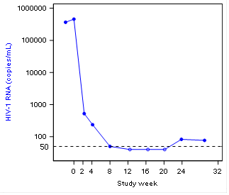
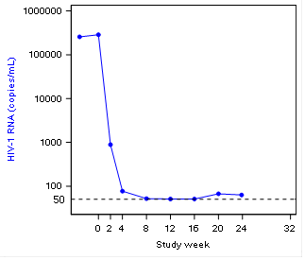
FDA Snapshot Virologic Non-Success: HIV-1 RNA to Week 24
>100k
>100k

Slide 12
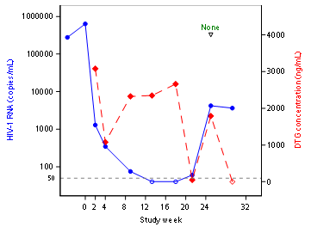
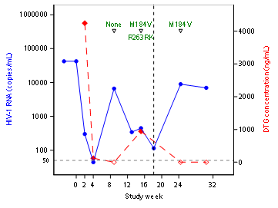
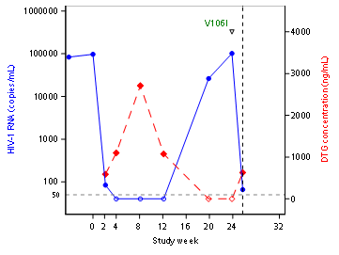
Protocol-Defined Virologic Failures (PDVF): HIV-1 RNA and DTG Levels to Week 24
>100k
HIV-1 RNA less than limit of detection .
No DTG drug level detected.
Off DTG/3TC
Off DTG/3TC
<100k
<100k

Slide 13
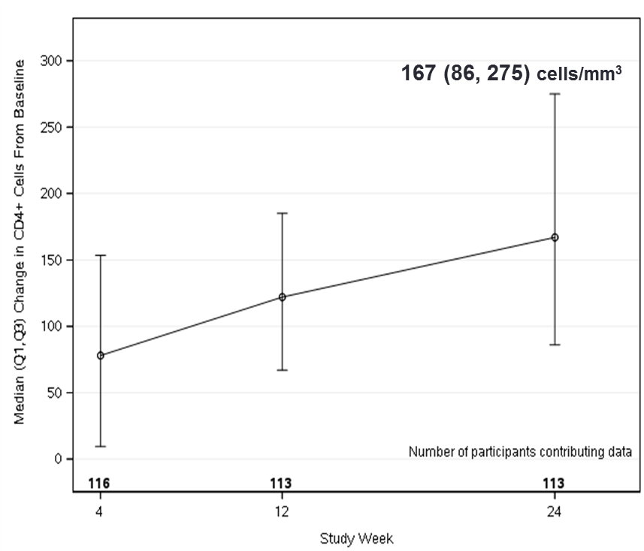
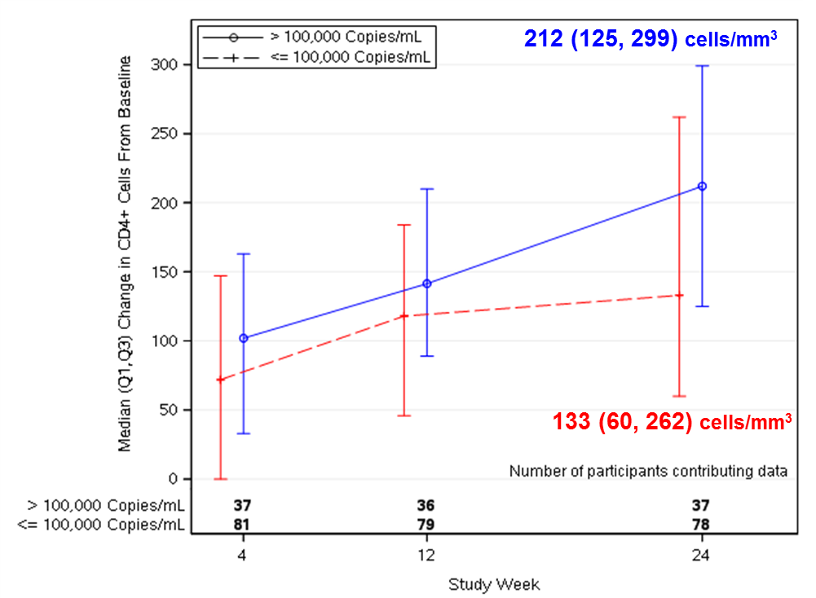
CD4 Count Changes

Slide 14
Adverse Events
Two participants experienced Grade 3 possibly/probably treatment-related adverse events
Creatinine clearance
Palpitations
No Grade 4 adverse events
No discontinuations due to adverse events

Slide 15
Conclusions
In this pilot study, DTG+3TC demonstrated potent virologic efficacy with study entry VL up to 500,000 copies/mL
Virologic failure was uncommon and associated with suboptimal adherence
3 patients met PDVF, one of whom had emergent R263RK mixture and M184V
Future work in A5353:
Investigate baseline and on-treatment RT and INI minority variants in the participants with virologic failure and a matched control group
Perform phenotyping on the participant with emergent R263K/R mixture
Analysis of pharmacogenetics associations
Two large randomized studies (GEMINI-1 and GEMINI-2) are underway and will provide more data on the resistance barrier of DTG+3TC

Slide 16
Acknowledgements
CRS
Rush
Greensboro
Northwestern
Miami
Colorado
Houston
UNC
Vanderbilt
Trinity
Ohio State
Wash U
Miriam
Chelsea
A5353 Team
Co-Chairs: Babafemi Taiwo, Trip Gulick
Clinical Trials Specialist: Elizabeth Hawkins
Statistician: Summer Zheng, Andrei Stefanescu
Data Managers: Melissa Mineo, Bernadette Jarocki
Pharmacist: Oladapo Alli
Virologist: Carole Wallis
Investigators: Amesika Nyaku, Paul Sax, David Haas, Johnstone Kumwenda
Field Reps: Baiba Berzins, Tanisha Sullivan
Lab Tech: Gerald Tegha
Lab Data Managers: Adam Manzella, Allison Reding, Laura Hovind
CSS: Angel Hernandez
DAIDS: Katy Godfrey
ViiV: Kim Smith, Belinda Ha
USC
Puerto Rico
Brigham
Harbor
UCSD
Cincinnati
Emory
Cornell
Penn
Columbia
Rochester
MGH
UCLA
Sponsored by NIAID
Industry Support Provided by ViiV Healthcare
THANKS to
A5353 PARTICIPANTS

Slide 17
Extra Slides

Slide 18
FDA Snapshot Endpoints at Week 24
 | Stratum | Wk 0 | Wk 2 | Wk 4 | Wk 8 | Wk 12 | Wk 16 | Wk 20 | Wk 24 | Snapshot Outcome (Week 24)
Virologic Non-success |  |  | HIV RNA (Copies/mL)
1 | >100,000 | 457,852 | 524 | 237 | 50 | 40 | 40 | 40 | 83 | VL>50
2 | >100,000 | 287,152 | 888 | 77 | 52 | 51 | 51 | 67 | 63 | VL >50
3 | >100,000 | 635,800 | 1292 | 347 | 75 | 40 | 40 | 60 | 4214 | VF
4 | <100,000 | 42,166 | 300 | 44 | 6,579 | 342 | 446 | 114* | 8892 | VF
5 | <100,000 | 97,299 | 84 | 40 | 40 | 40 |  | 26,231 | 101,637* | VF
No Virologic Data |  |  | HIV RNA (copies/mL)
1 | >100,000 | 192603 | 230 | 51 | 40 | 40 | 40 | 40 |  | Relocated
2 | <100,000 | 6564 | 40 |  |  |  |  |  |  | Relocated
3 | <100,000 | 20438 | 40 |  |  |  |  |  |  | Incarcerated
4 | <100,000 | 7422 | 40 | 40 | 40 | 40 | 40 | 40 |  | Missed wk 24 visit. Wk 32=40
5 | <100,000 | 59863 | 288 | 101 | 40 | 40 | 40 | 40 |  | Switched - Pregnancy
6 | <100,000 | 5149 | 40 | 40 | 40 | 40 | 40 |  |  | LTFU
7 | <100,000 | 6354 | 40 | 40 | 40 | 40 |  |  |  | LTFU
*DTG + 3TC discontinued

Slide 19
Protocol Defined Virologic Failures
 | Stratum | Week 0 | Week 2 | Week 4 | Week 8 | Week 12 | Week 16 | Week 20 | Week 24
VF 1
HIV RNA (copies/mL) | >100,000 | 635,800 | 1292 | 347 | 75 | 40 | 40 | 60 | 4214 / 3644++
DTG conc (ng/mL) * |  |  | 3079 | 1077 | 2325 | 2348 | 2661 | 50 | 1790 / <5
RT/INI mutation |  |  |  |  |  |  |  |  | None
Study Treatment |  | DTG/3TC | DG/3TC | DG/3TC | DG/3TC | DG/3TC | DG/3TC | DG/3TC | DG/3TC
VF2
HIV RNA (copies/mL) | <100,000 | 42,166 | 300 | 44 | 6,579 | 342 | 446 | 114 | 8892/ 6925++
DTG conc (ng/mL)* |  |  | 4242 | 123 | <5 |  | 943 |  | <5
RT/INI mutation |  |  |  |  | None |  | 184V, 263KR |  | M184V
Study Treatment |  | DG/3TC | DG/3TC | DG/3TC | DG/3TC | DG/3TC | DG/3TC | DRV/c,FTC/TAF | Off Treatment
VF 3
HIV RNA (copies/mL) | <100,000 | 97,299 | 84 | 40 | 40 | 40 |  | 26,231** | 101,637
DTG conc (ng/mL)* |  |  | 590 | 1102 | 2712 | 1077 |  | <5 | <5
RT/INI mutation |  |  |  |  |  |  |  |  | V106I
Study Treatment |  | DG/3TC | DG/3TC | DG/3TC | DG/3TC | DG/3TC | DG/3TC | On Treatment | OFF Treatment
VF definition: Week 16 or 20: confirmed HIV-1 RNA > 400 copies/mL;
Week 24 or later: confirmed HIV-1 RNA > 200 copies/mL
*IC90 = 64 ng/ml <5 = below the level of detection while on study treatment

Slide 20
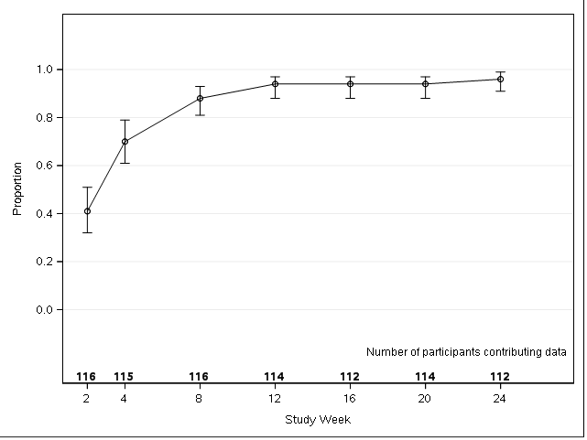
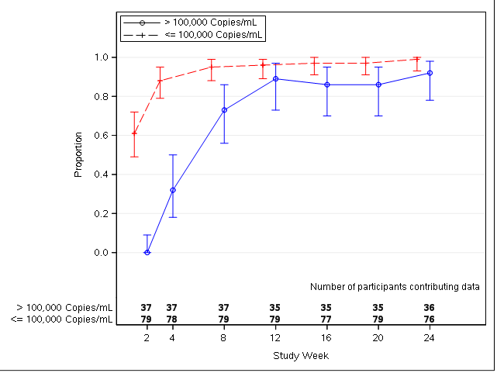
As-Treated Analysis: Proportion of Participants With HIV-1 RNA < 50 copies/mL by Week
99% [93%, 100%]
96% [91%, 99%]
92% [78%, 98%]

Slide 21
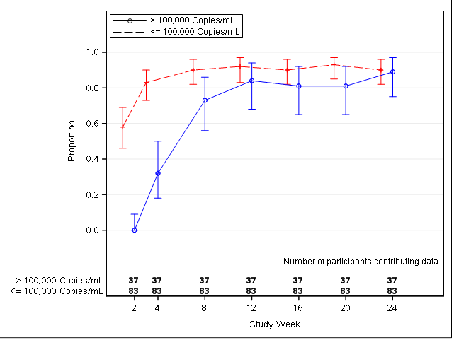
ITT Analysis (missing = failure): Proportion of Participants With HIV-1 RNA < 50 copies/mL by Week
90% [82%, 96%]
90% [83%, 95%]
89% [75%, 97%]

